Slide 1

Interconnection and Damping Assignment Passivity-Based Control of Mechanical Systems With Underactuation Degree One

Slide 2
Passivity based position control for vtol dynamics (Port-hamiltonian system)
La Sala - Scuderi

Slide 3
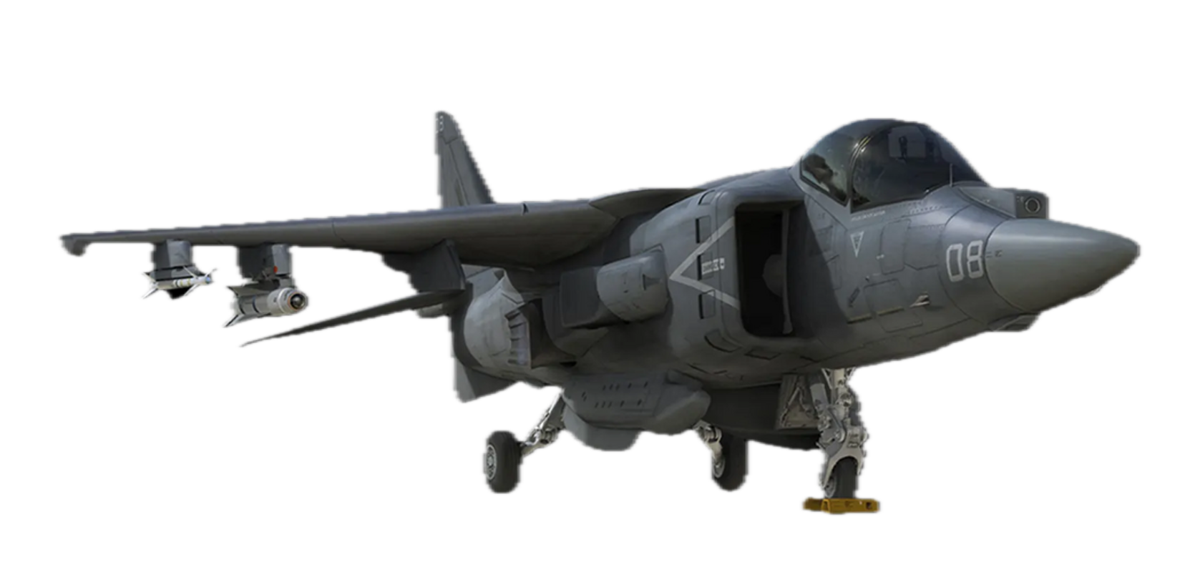
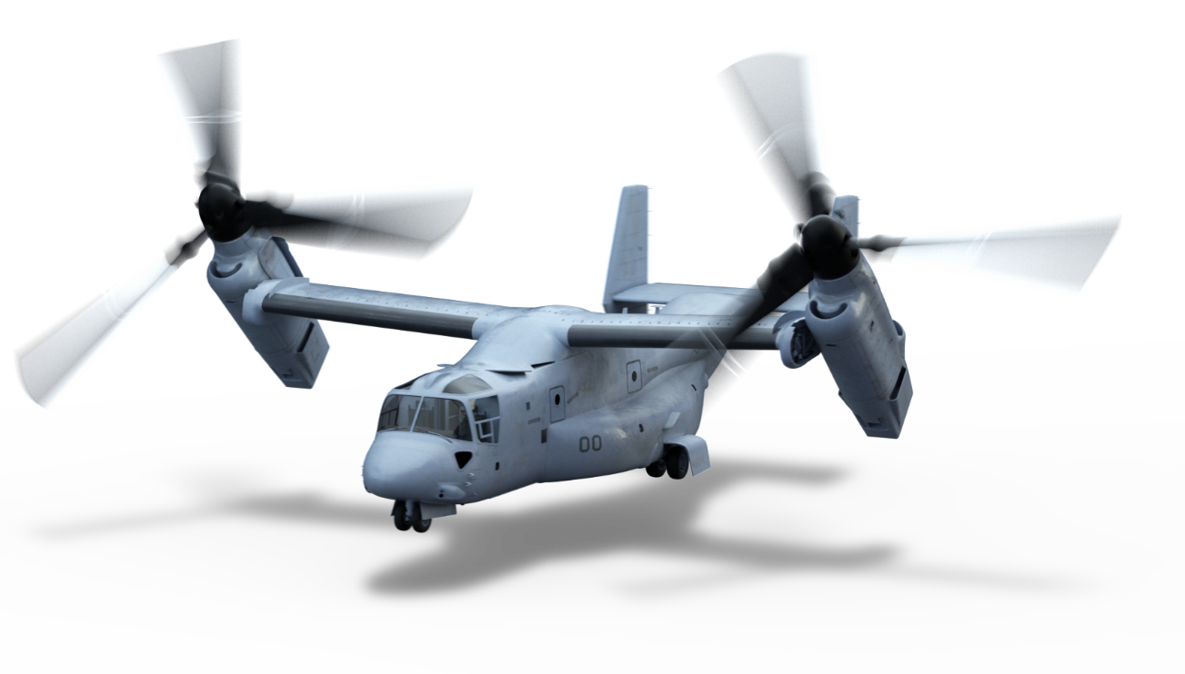
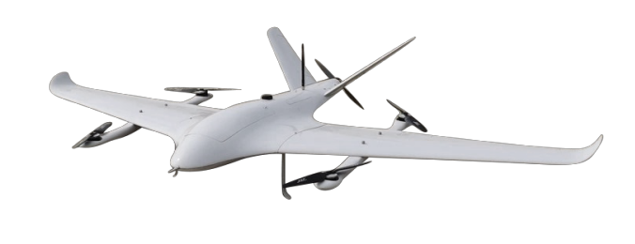
What is a VTOL?
Vertical Take-off and Landing Aircraft
Doesn’t need a landing strip.
Can land and take-off like an helicopter
Jet Structure (F-35B)
Drone-Like Structure
Tri-rotor Structure

Slide 4

Used for what?
EXPORT DEMOCRACY

Slide 5
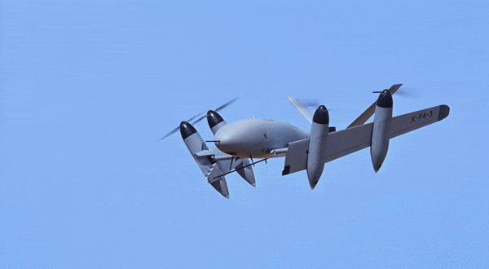

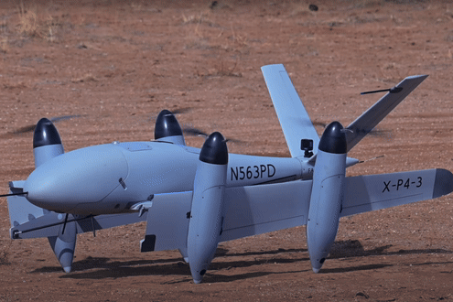
How does it work?
Phase 2:
Flight
Phase 3:
Landing
Phase 1:
Take-off

Slide 6
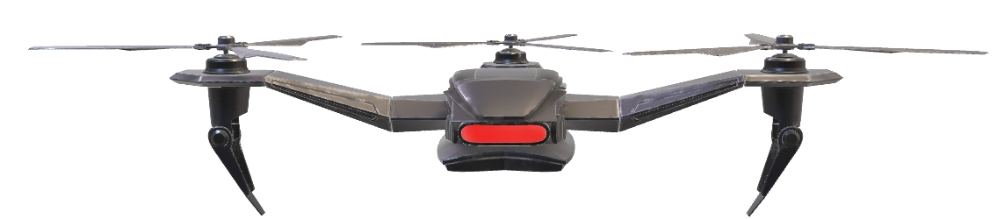
Our Goal:
Reach a desired position
x_{d} with zero velocity
Start From an initial position x₀

Slide 7
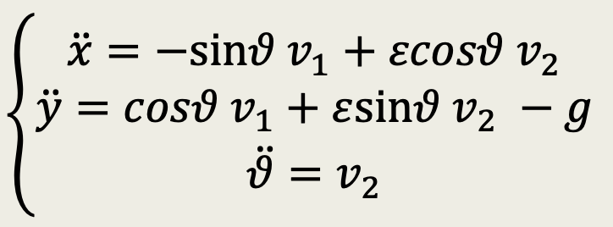
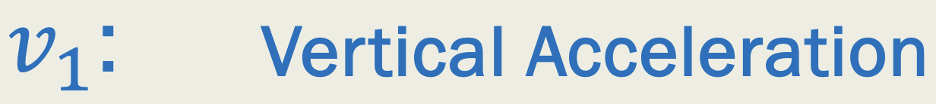



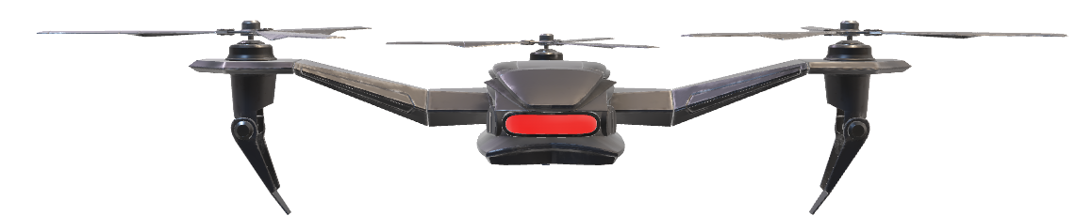
Model
y
g
RF0
x

Slide 8
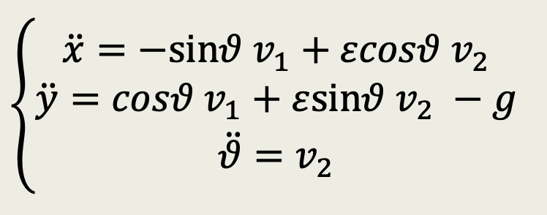
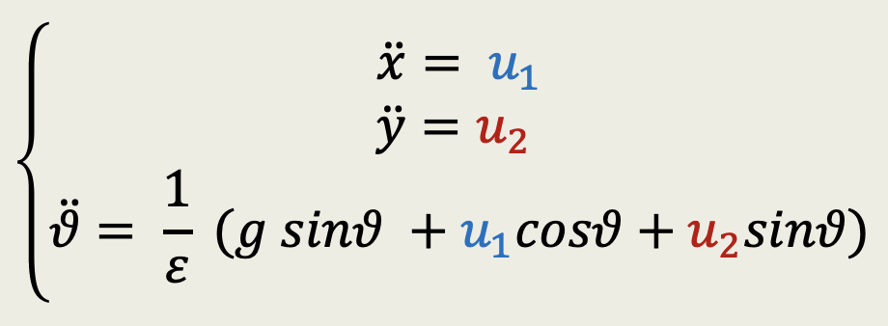
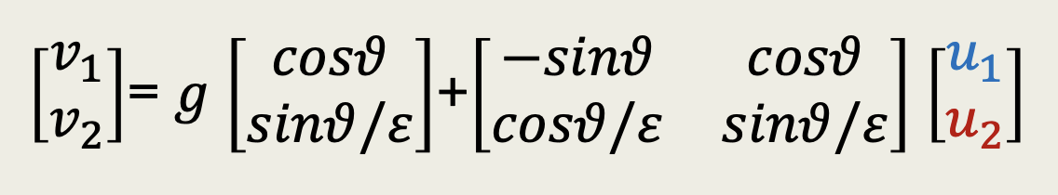
Change of input
Globally defined!

Slide 9
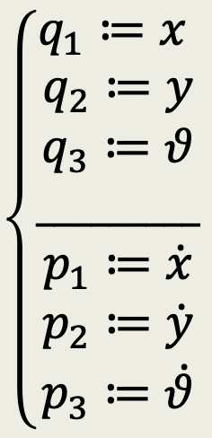
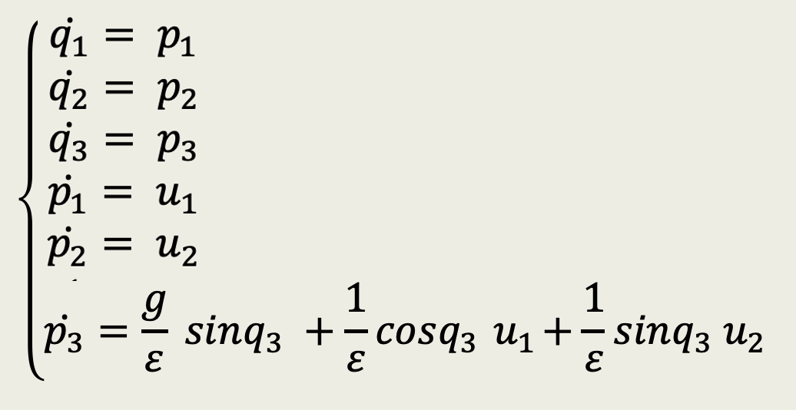
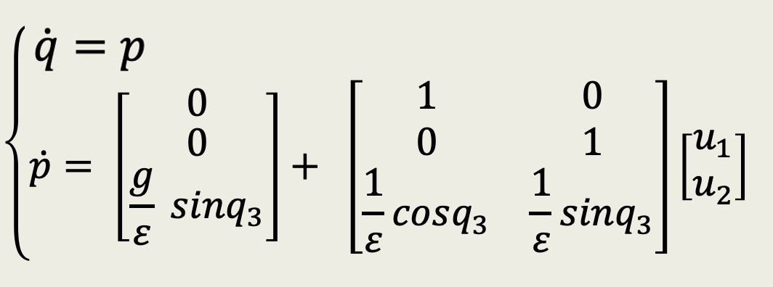

State Space Representation
Compact Form
G

Slide 10
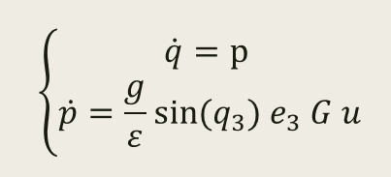
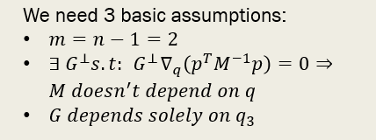
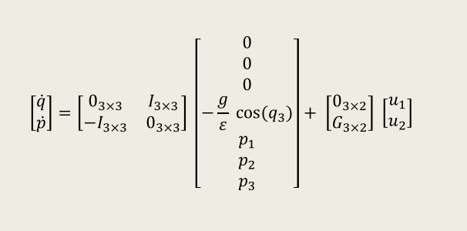
Port-Hamiltonian form

Slide 11
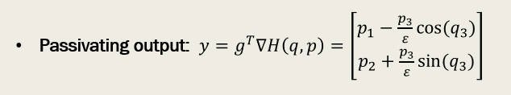
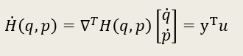
Passivity
The system is passive w.r.t this storage
function and this passivating output.
In addiction the system is lossless as we expected, since there isn’t any damping.

Slide 12
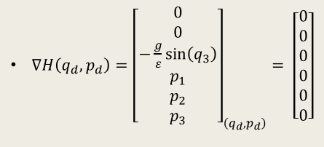
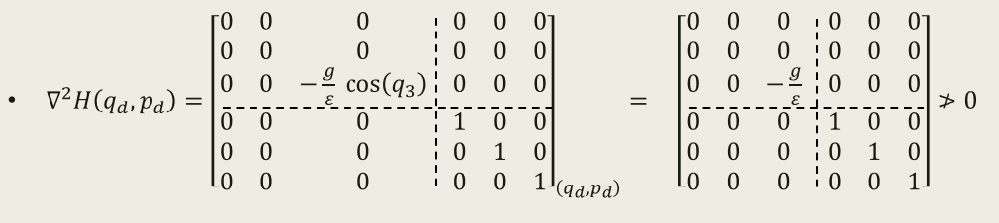
Necessity of using IDA-PBC
✓
✗

Slide 13
What now?
REMEMBER:
Passive System! (Port-Hamiltonian Form)
Energy Shaping
+
Damping Injection
under
Zero State Detectability
=
Asymptotic Stability

Slide 14
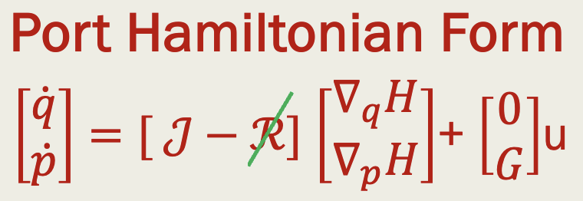
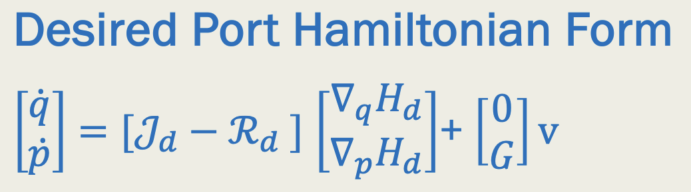
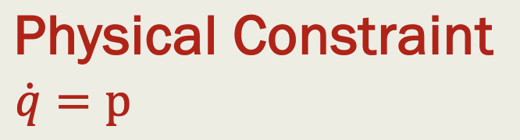
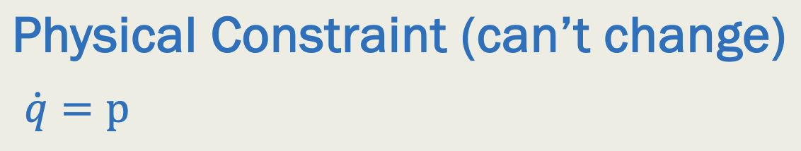
Energy Shaping… (wishful thinking)
WHAT WE HAVE (OPEN LOOP)
WHAT WE WANT (CLOSED LOOP)
Storage Function
Desired Storage Function
H(q,p) such that (q*,p*) is NOT a minimum of H
H(q,p) only positive semidefinite (not a LF)
H_{d}(q,p) such that (q*, p*) is a minimum of H_{d}
Choose H_{d}(q,p) that qualifies as a Lyapunov Function

Slide 15
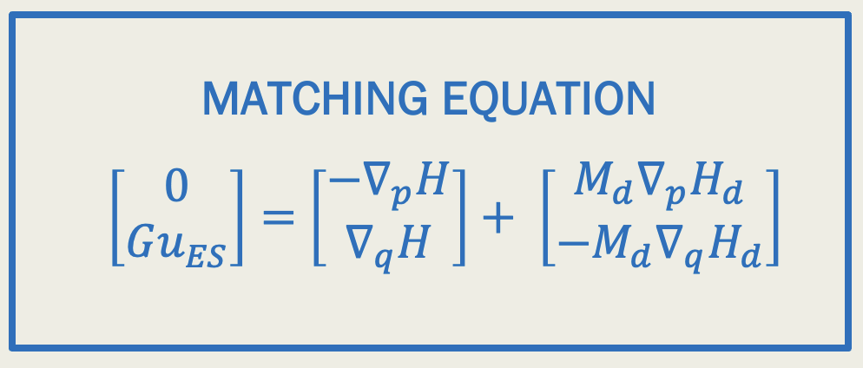
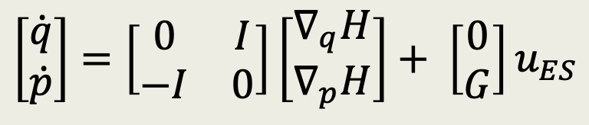
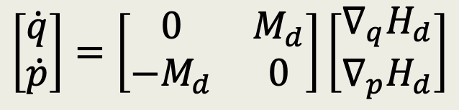
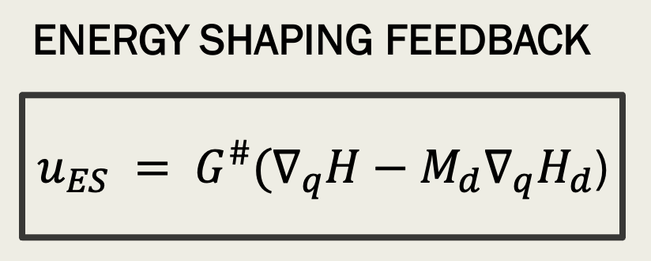
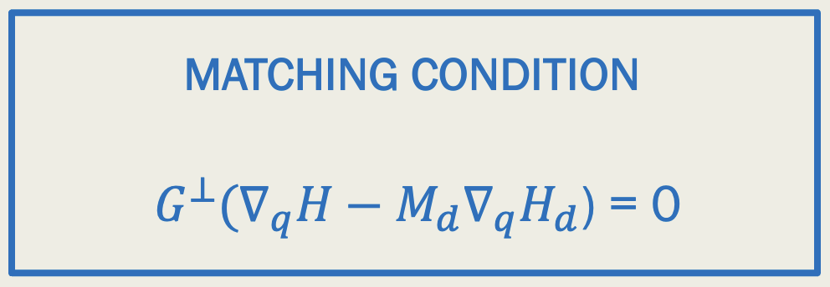
Interconnection and Damping Assignment
BEFORE ENERGY SHAPING:
EQUATE
AFTER ENERGY SHAPING:
There exist a solution
IF AND ONLY IF
THE MATCHING CONDITION HOLDS
SOLVE PDE

Slide 16
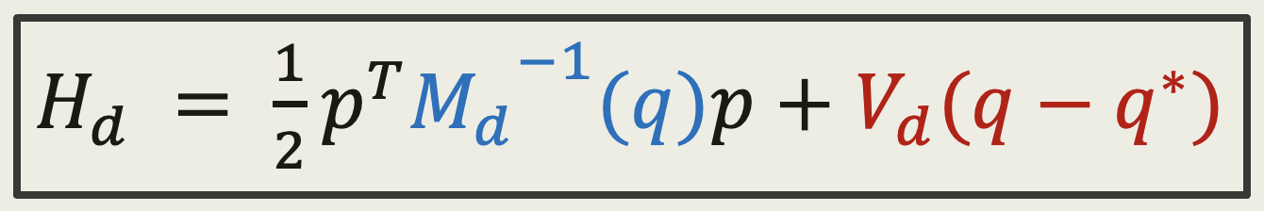
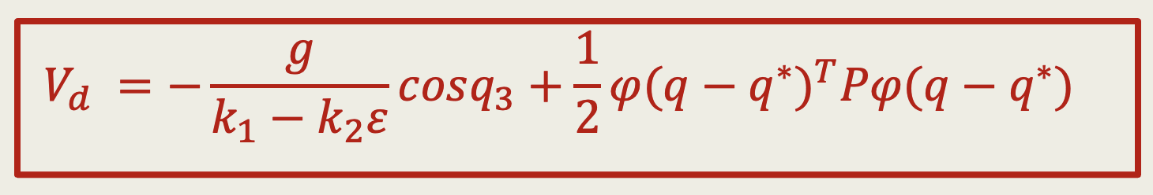
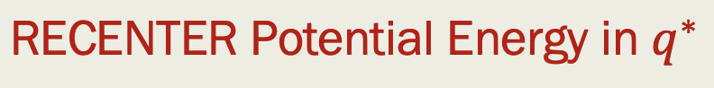
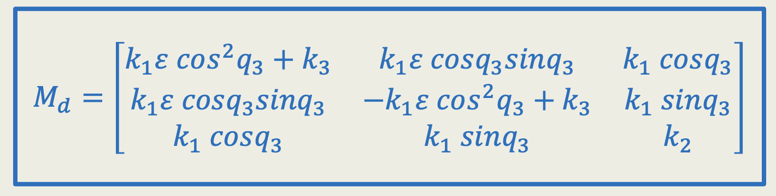
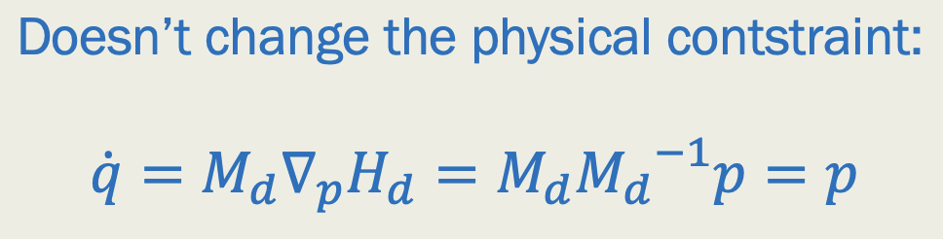
What about Hd?
Needed due to underactuation

Slide 17
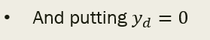
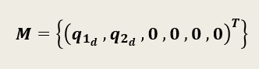
Zero State Detectability
To use the damping injection, we need that the system is Zero State Detectable:
$⇒$ the system is Z.S.D and moreover it is Z.S.O

Slide 18
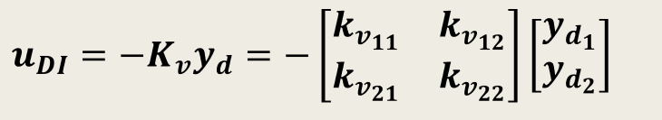
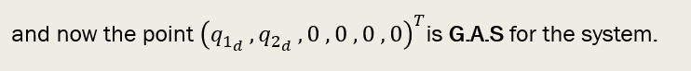
Damping Injection
Since we have proved that the system is Z.S.D, we can apply the damping injection:

